Slide 1
Chrome River Overview: Travel and Non-Travel Expense Reimbursement
Presented by: Office of the Controller
Last Updated: 06/07/2024

Slide 3
Agenda
Timeline | Access
Chrome River Profile Updates
General Navigation
Pre-Approvals
Travel Reimbursements
Cash Advances
Non-Travel Reimbursements
Tracking Approvals
Approvals
Delegate Functionality
Roles and Responsibilities
Additional Resources

Slide 4
Timeline | Access
Timeline
The Chrome River Pre-Approval and Expense modules launched on June 3, 2024.
The PCard reconciliation in Chrome River Expense will go live after the fiscal year end close beginning with the transactions dated June 26, 2024.
Access
The Chrome River link is available on the Accounts Payable or the Procurement Services webpages, as well as the IT Chrome River project page
Chrome River uses Single Sign-On access

Slide 5
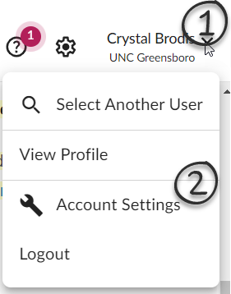
Profile Updates
Update your profile!
Add an alternate email address
Add delegate(s) that can help you prepare and submit your Pre-Approvals and/or Expense Reports
Add an Approval Delegate
Click on the drop-down by your name in the upper right-hand corner
Click on Account Settings
Reference the Chrome River User Guide for step-by-step instructions.

Slide 6
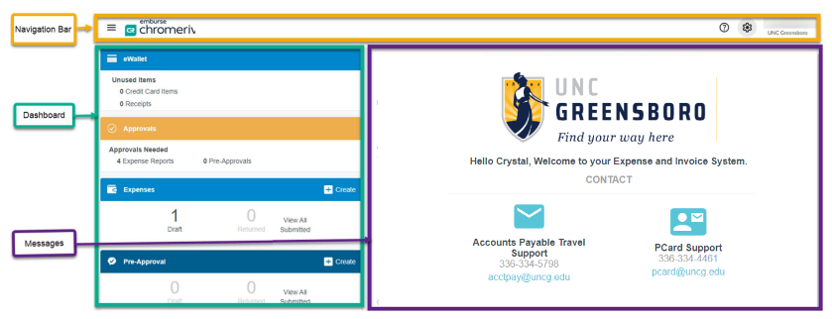
General Navigation
Once logged in, you will arrive at the Chrome River home screen. At the top of the screen, you will find the Navigation Bar. The left side of the screen contains your Dashboard, and the right side of the screen contains Company Information with links to helpful information.

Slide 7
General Navigation
Navigation Bar – Click on the ‘Emburse Chrome River logo’ at any point and it will take you back to the main logon page
Dashboard
eWallet – this section will show any card transactions that fed in automatically from Bank of America each night as well as receipts sent in via email, the mobile app, or Amazon Business
Approvals – The approval ribbon dynamically shows IF you have a Pre-Approval or Expense report pending your approval
Expenses – This will show your Draft reports, any Returned reports and you can access any Submitted reports
Pre-Approval – This will show your Draft pre-approvals, any Returned pre-approvals and you can access any Submitted pre-approvals
Company Information– Look here for updates, links to additional help resources, including the email address where you can forward your receipts by email and links to download the mobile apps.

Slide 8
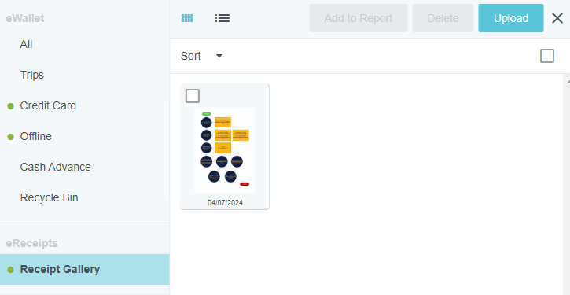
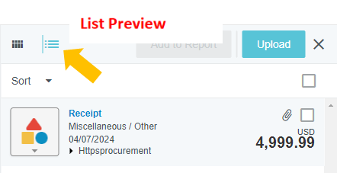
General Navigation
Chrome River’s Receipt Gallery
Upload to Gallery - Directly from Desktop
Access Receipt Gallery by opening main menu on the top left corner and choosing the eReceipts option.
Use the Upload button or drag and drop files from your desktop to add them to the Gallery.
Receipts are shown as a preview picture or a list.
Picture Preview

Slide 9
Pre-Approvals
Complete a Pre-Approval
All overnight travel will require a Pre-Approval to be completed
Attach supporting documentation (ex. itinerary) to the Pre-Approval using the Attachment functionality (save it first!)
Complete the expected expenses, marking any that will be paid on the PCard as “University Paid”
Click on the +Create button in the Pre-Approval ribbon
Reference the Chrome River User Guide for step-by-step instructions.

Slide 10
Travel Reimbursements
A Pre-Approval must be completed before you travel (overnight) and is required to complete a Travel Expense Report.
Travel Expense Reports are due within 30 days of the Trip End Date
All expenses related to a travel event should be included in your Travel Expense Report
You can use the approved Pre-Approval to ‘create’ your expense report and then update as appropriate and attach your receipts.
Reference the Chrome River User Guide for step-by-step instructions.

Slide 11
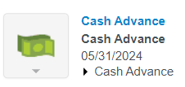
Cash Advances
Cash advance requests and reconciliation will be handled in Chrome River now.
Include your ‘expected’ cash advance amount in your Pre-Approval request by entering it as an ‘Other’ amount and provide the necessary description.
Once the Pre-Approval is fully approved, complete an Expense Report for your requested Cash Advance amount.
Once approved, the cash advance will be issued.
Complete your Expense Report after the trip completes and add your Cash Advance transaction to the report for reconciliation.
Any unused funds will need to be returned to the University Cashiers Office
Reference the Chrome River User Guide for step-by-step instructions.

Slide 12
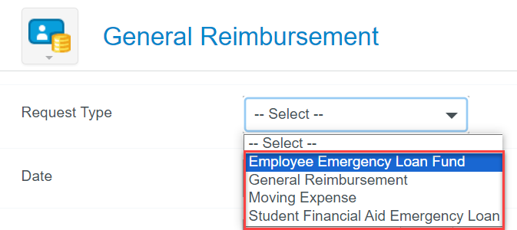
Non-Travel Reimbursements
Non-Travel Expense Reports are due within 30 days of receipt date
There are four types of General Reimbursement available:
Employee Emergency Loan Fund
General Reimbursement
Moving Expense
Student Financial Aid Emergency Loan
Each type can have different data and approval requirements
Reference the Chrome River User Guide for step-by-step instructions.

Slide 13
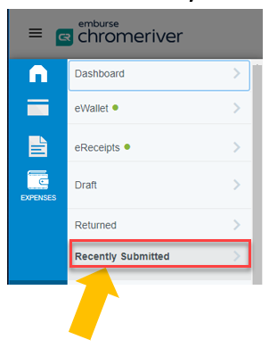
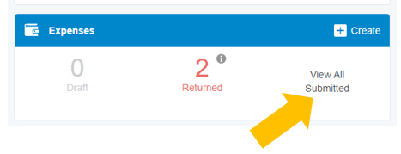
Tracking Approvals
When an Expense Report or a Pre-Approval is being routed through the approval process, the status can be tracked by the cardholder or their delegate.
To view the status of a submitted expense report, complete the following:
Go to the dashboard and click the View All Submitted option on the Expenses or Pre-Approval Bar
(or click on Recently Submitted from the left menu )
Find and click on the appropriate expense report
Click on the Tracking button to view the status and assignment of the line items

Slide 14
Approvals
If you’re an approver with Pre-Approvals or Expense Reports pending your approval, you will see the Approval ribbon on your home page
Approvals can be completed via the browser, the mobile app or via email!
As an approver you can return a report for correction, edit the allocation (Fund), add comments, view and add attachments, or reassign approval to someone else.
The approval routing steps in Chrome River are dynamic and systematically routed based on the report qualities, which include: the type of report, the allocation, the department, etc.
Reference the Chrome River User Guide for step-by-step instructions.

Slide 15
Approvals
Approval through Chrome River Dashboard
For a more thorough review of the expense report and the ability to adjust and make changes per line item, approval through the Chrome River Dashboard is recommended.
If an expense report is awaiting your approval, your dashboard will display an orange Approval bar at the top of your dashboard.
Click Expense Reports in the Approval Bar to view the Approvals Needed List
Choose the report you would like to review for approval and click Open to view each line item

Slide 16
Approvals
Approval through Chrome River Dashboard (cont’d)
As approver, you will have the ability to review each individual line item with the following options:
Reconcile: Marks expense as okay and ready for approval
Reassign: Assign the expense to another approver and send a note to that individual.
Adjust: Allows approver to make an adjustment to the Business Purpose, Allocation*, and/or Uploaded documentation. Adjustment comment will be required.
Return: Return the expense line item to the dashboard of the cardholder for changes.
After expenses have been reviewed and adjusted (if necessary), click the Submit button to approve.
If expense report does not meet requirements, click the Return button to send back to the cardholder’s dashboard for correction.
*NOTE - Important Reminder regarding allocation adjustments for Expense Report Approvers:
Please ensure when any change is made to an expense for funding allocation that the funding has sufficient budget for the transaction.

Slide 17
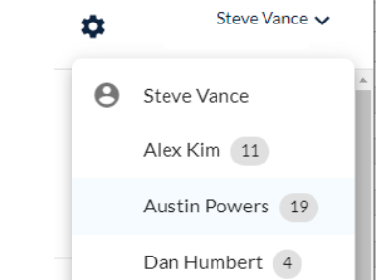
Delegate Functionality
Chrome River supports delegate activity at both the User and the Approval levels. When you’ve been added as a Delegate you will be able to create/prepare and submit Pre-Approvals and Expense Reports for the person you are supporting.
When you have been authorized to work as someone's delegate, you will see their names under your name when you click in the upper right-hand corner.
When you’ve been set-up as a Delegate Approver, you’ll be able to temporarily approve both Pre-Approvals and Expense Reports on behalf of the approver.
Reference the Chrome River User Guide for step-by-step instructions.

Slide 18
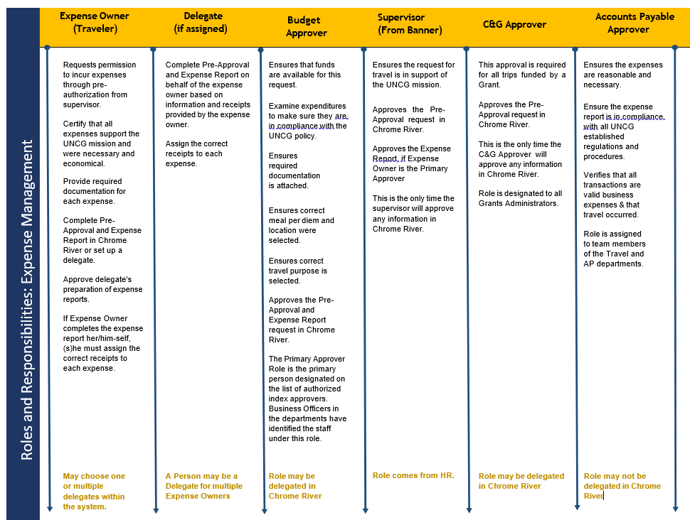
Roles and Responsibilities

Slide 19
Additional Resources
ITS Information: https://technologyinitiatives.uncg.edu/chrome-river/​
Chrome River Login: https://chromeriver.uncg.edu
Accounts Payable: https://accountspayable.uncg.edu/chrome-river/
Chrome River User Manual: https://accountspayable.uncg.edu/wp-content/uploads/Chrome-River-User-Guide.pdf
Chrome River Help Portal: https://help.chromeriver.com/hc/en-us
A/P Travel Support: acctpay@uncg.edu
PCard Support: pcard@uncg.edu

